Slide 1
A Major Lifestyle A Follow up to The True Meaning behind “Decision Day”
Nikita Jones
Anush Rama
Edward Gates, Jr.
Danica Rios
Mason Waters

Slide 2
Agenda
Project Purpose
Problem Analyzed/Visualized
Learned Technologies Used
Machine Learning

Slide 3
Project Purpose
Serves as a follow up to Project #1 where there was analysis and comparison of starting, mid-career, and 90th percentile salaries based on College Type, Major and Region of institution
This project aims to assist in user decisions based on lifestyle preferences

Slide 4
Problem Analyzed/Visualized
The previous project was seeking to discredit the notion that higher tuition rates exclusively resulted in higher salaries
With machine learning, this project is seeking to predict the best region to reside by taking into consideration the living expenses and a chosen degree to support a desired lifestyle

Slide 5

Learned Technologies Used
Python (Pandas, Matplotlib)

Slide 6
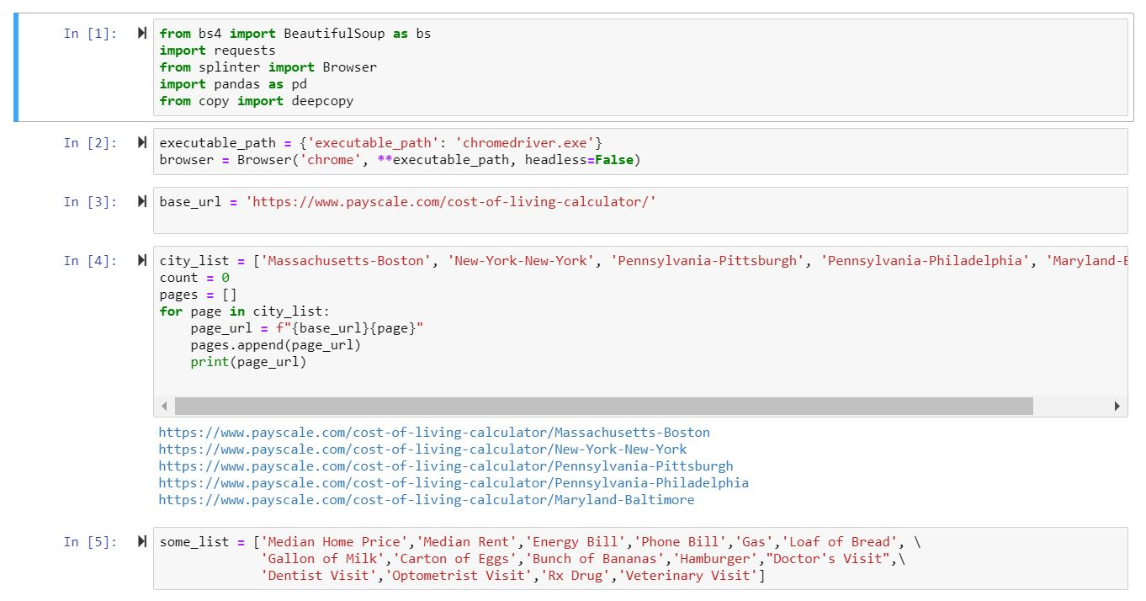
Learned Technologies Used - Python
Pandas

Slide 7
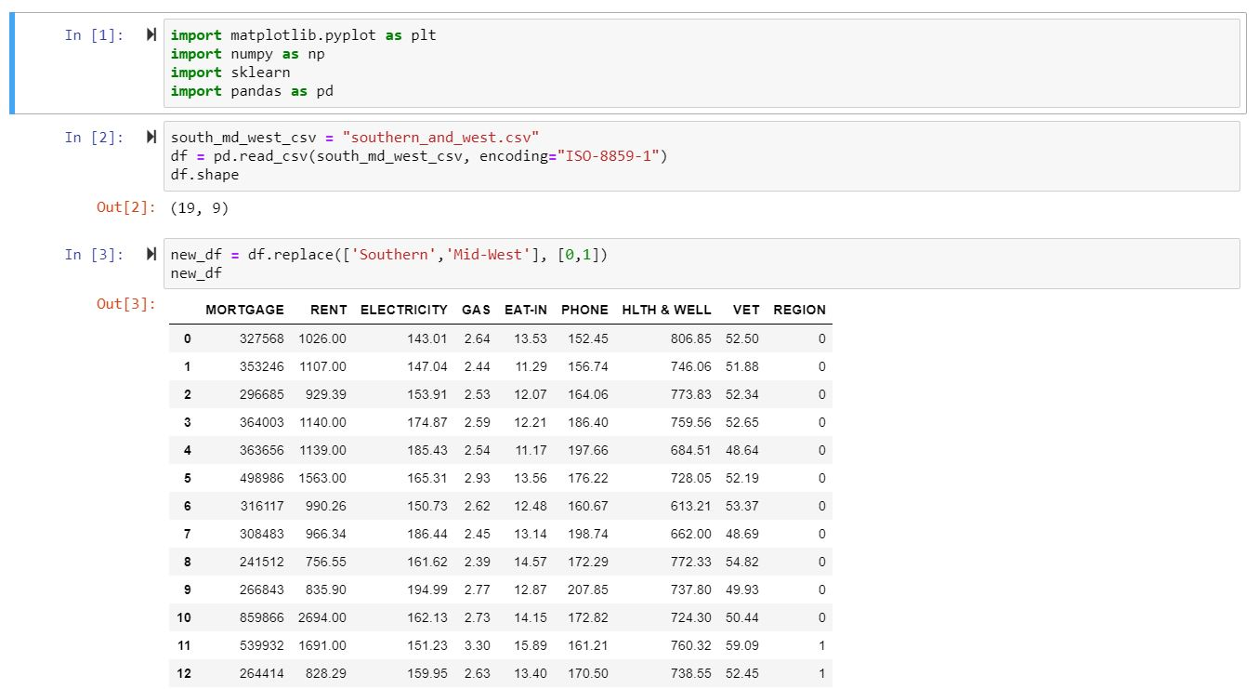
Learned Technologies Used - Python
Matplotlib

Slide 8

Learned Technologies Used
Tableau

Slide 9
Learned Technologies Used - Tableau
Region By State – College/University - Lifestyle
Salaries vs Expenses
Avg Mortgage vs Rent by Region
Avg Min Annual Exp - Rent vs Mortgage

Slide 10
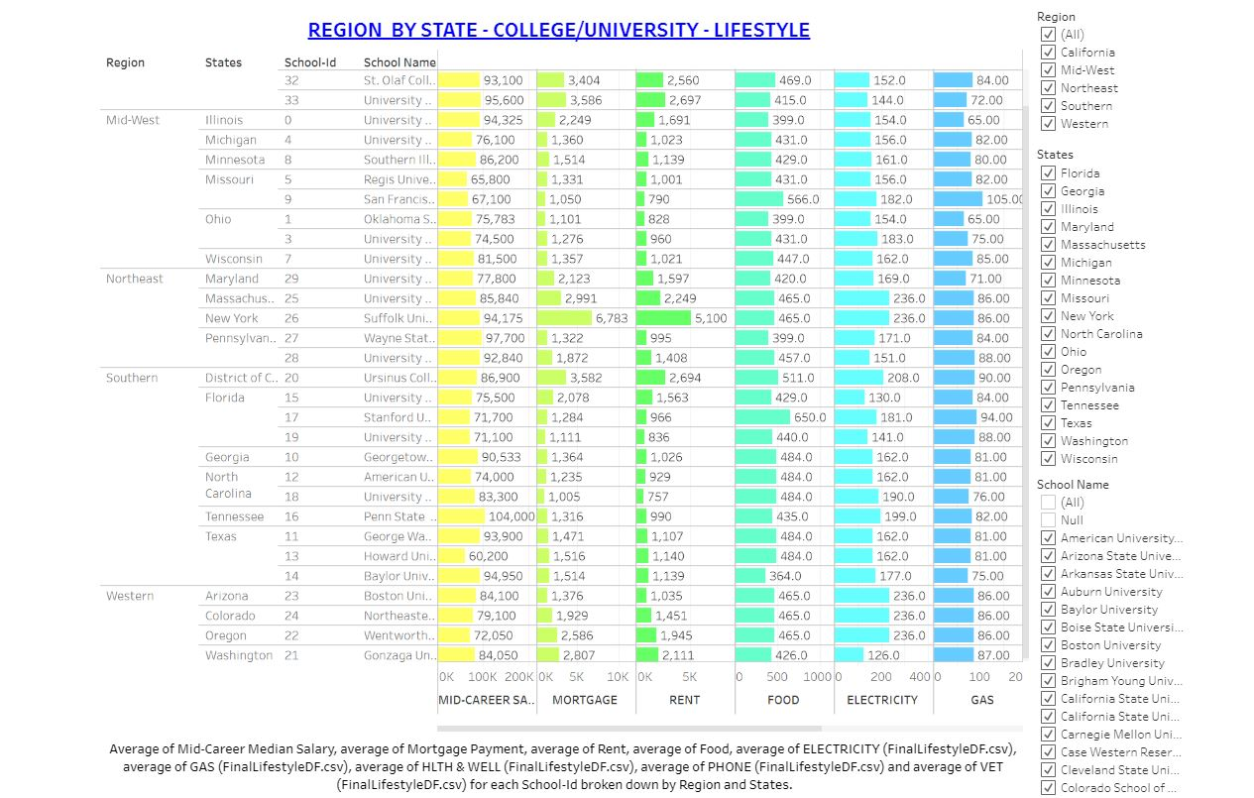
Learned Technologies Used - Tableau
Region By State – College/University - Lifestyle

Slide 11
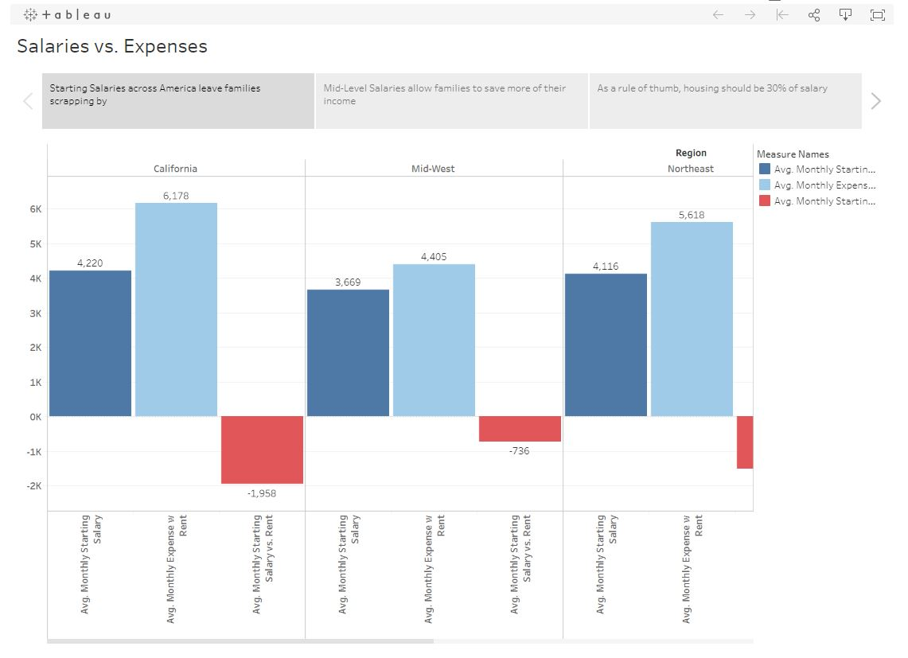
Learned Technologies Used - Tableau
Salaries vs Expenses

Slide 12
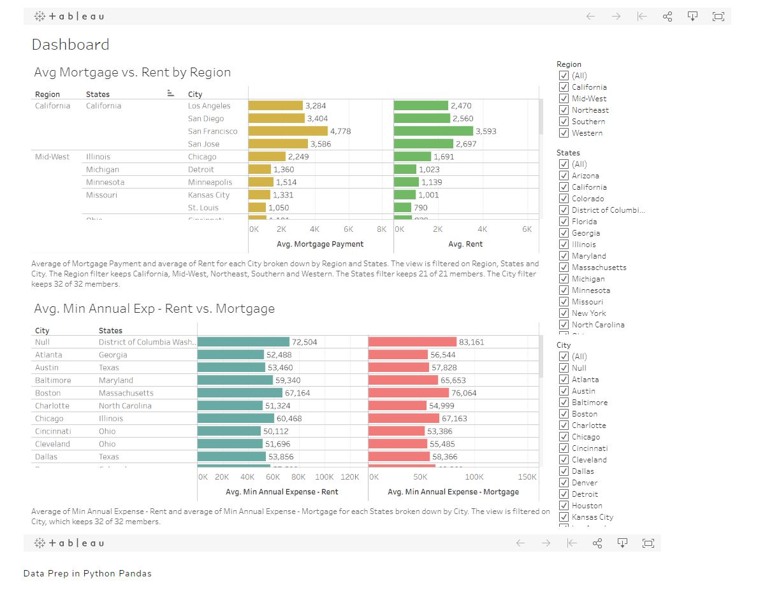
Learned Technologies Used - Tableau
Avg Mortgage vs Rent by Region

Slide 13
Learned Technologies Used - Tableau
Avg Min Annual Exp - Rent vs Mortgage

Slide 14
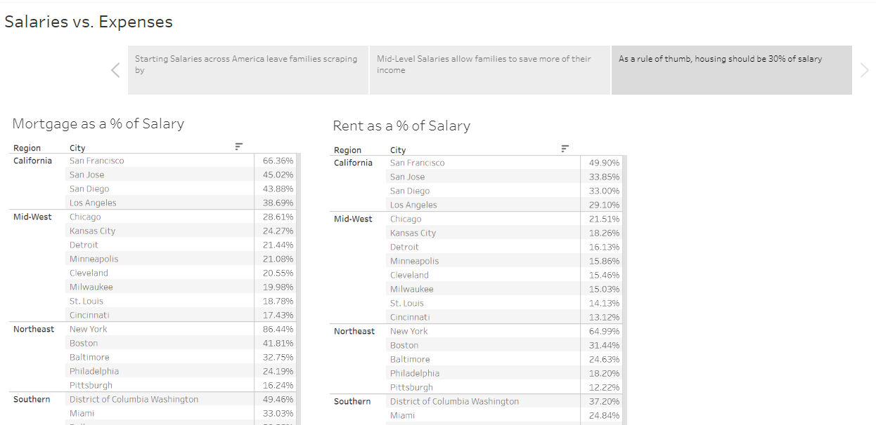
Learned Technologies Used - Tableau
Housing as a Percentage of Salary

Slide 15

Learned Technologies Used
Considered but not used
Amazon AWS

Slide 16
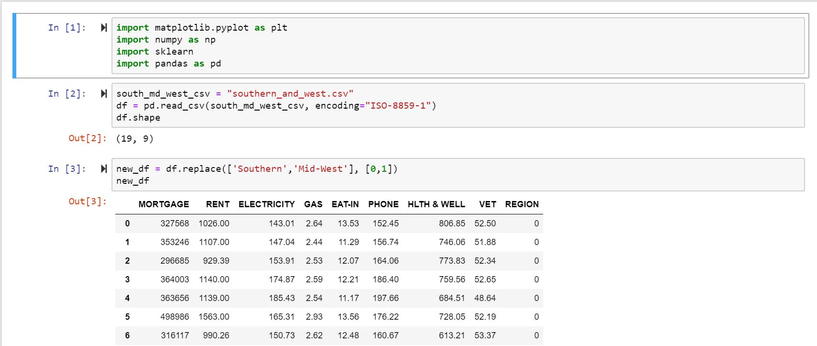
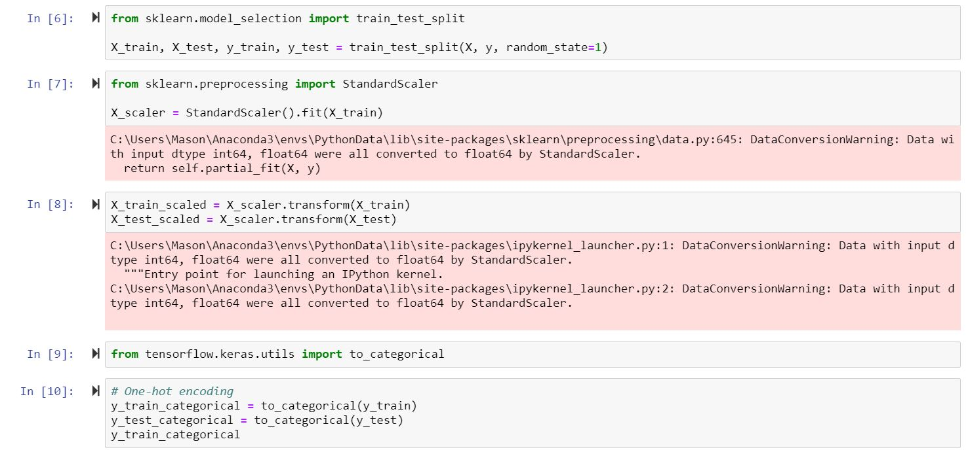
Machine Learning
Use of Scikit-Learn library
Deep Learning & Neural Networks

Slide 17
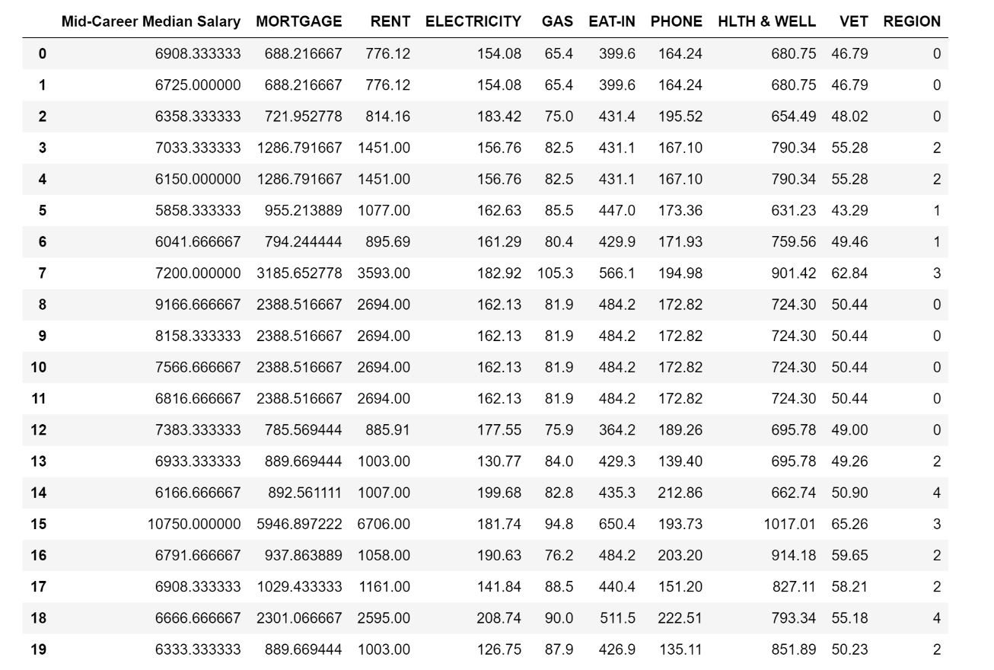
Machine Learning
Training

Slide 18
Machine Learning

Slide 19
Machine Learning

Slide 20
?
Any questions?
?
?

